Slide 1
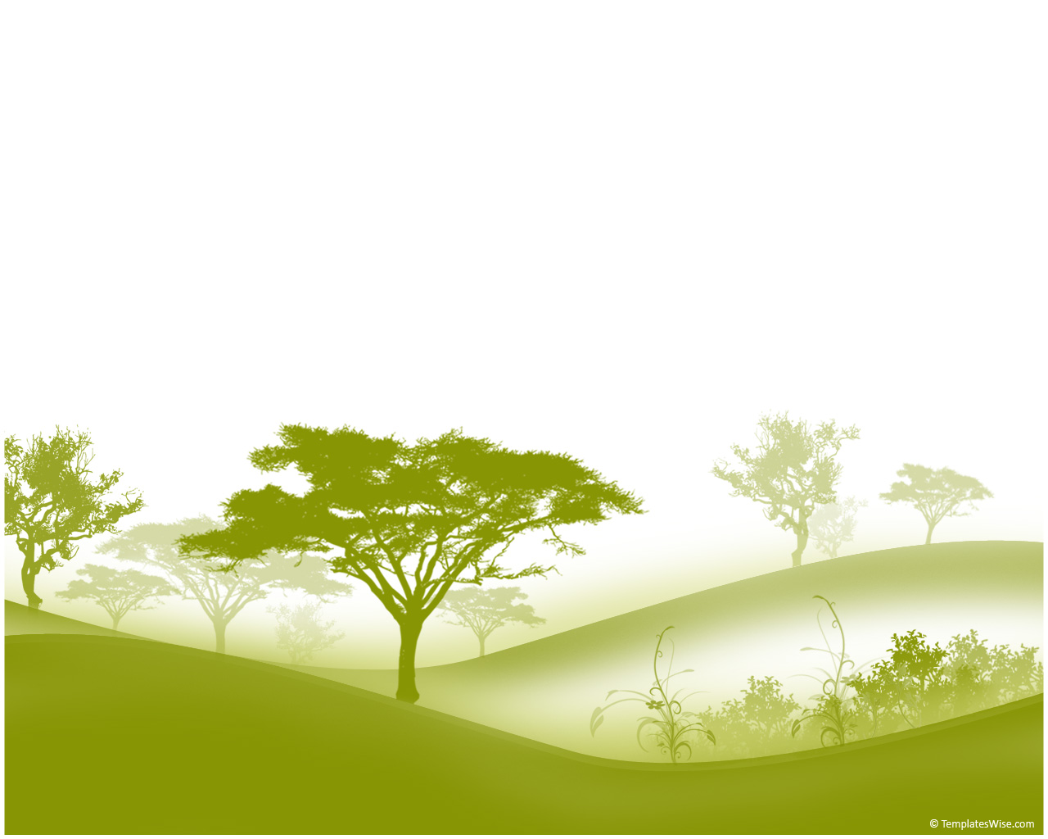
Evolving multicellularity in a test tube
William C. Ratcliff and Jennifer Pentz
Georgia Institute of Technology
Notes:
Today we are going to start a lab in which we will evolve multicellularity in a test tube! First, let me introduce the topic of the evolution of multicellularity.

Slide 2
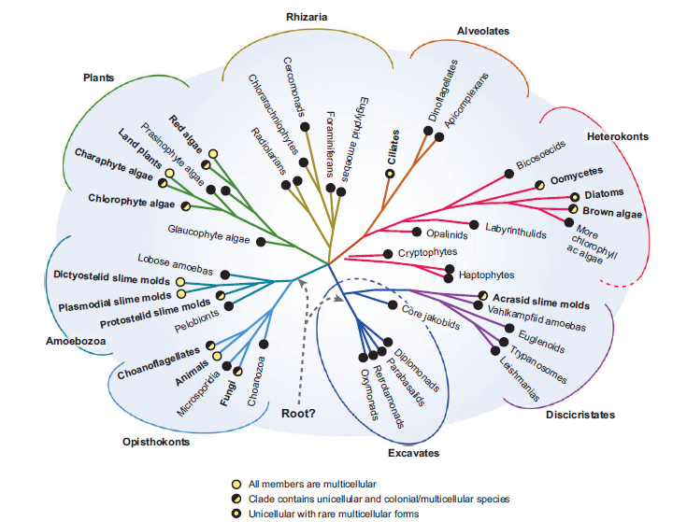
Multicellularity has evolved at least 25 times in the history of life!
Grosberg R. K., and R. R. Strathmann. 2007. Annu. Rev. Ecol. Evol. Syst. 38:621-654
Notes:
Multicellularity has evolved not one, not twice, but at least 25 times in the history of life in different lineages! Here is a phylogeny showing independent origins of multicellularity. All groups represented with a yellow circle contain multicellular organisms.

Slide 3
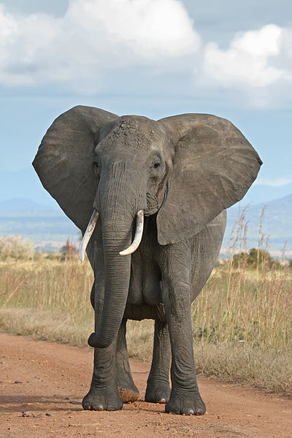
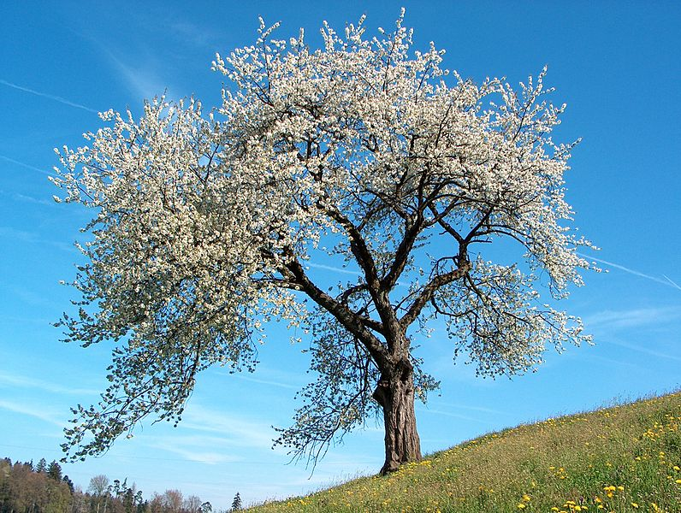
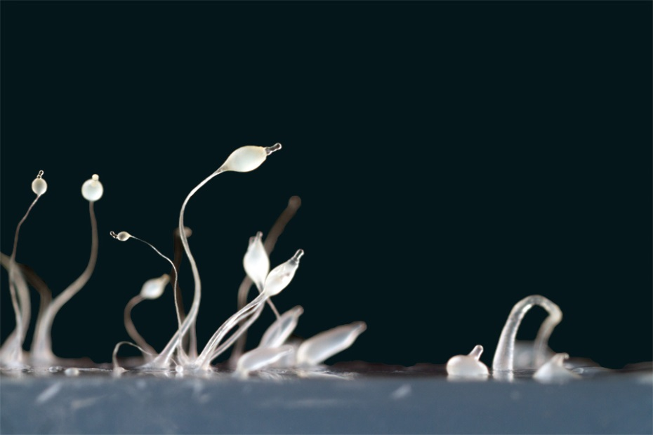
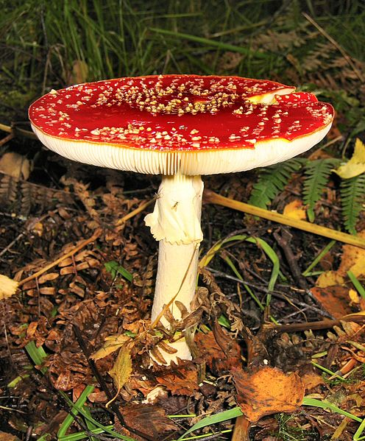
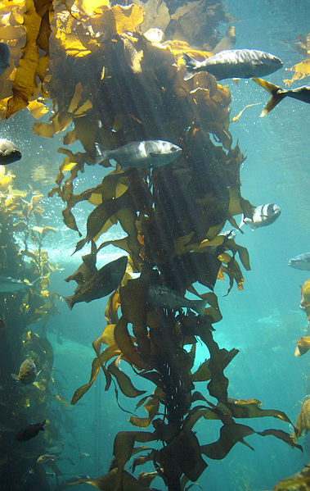
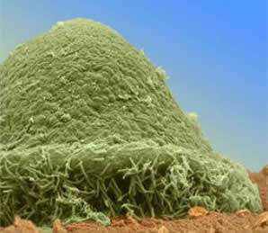
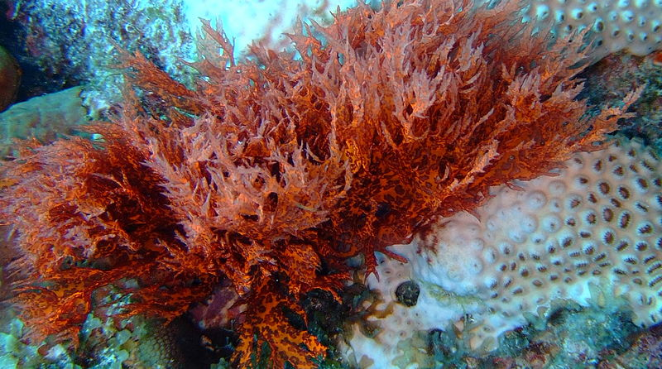
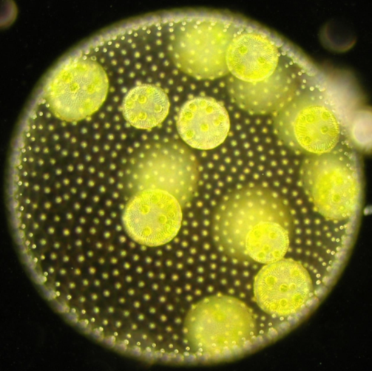
Examples of independently-evolved multicellular lineages
Notes:
Here are some examples of independently-evolved multicellular lineages. We have animals, plants, a couple kinds of slime molds, and red, brown, and green algae. All of these lineages independently evolved multicellularity.
Copyrights
1. Elephant - © Muhammad Mahdi Karim
2. Tree (Prunus cerasus) - © Benjamin Gimmel
3. Dictyostelium - © Alex Wild
4. Fungus (Amanita muscaria) - © Tim Bekaert
5. Myxococcus xanthus - © Velicer lab
6. Brown algae - © Stef Maruch at Monteray Bay aquarium
7. Red Algae – © http://creativecommons.org/licenses/by-sa/3.0/deed.en
8. Volvox - © http://www.cam.ac.uk/research/news/stirring-tails-of-evolution

Slide 4
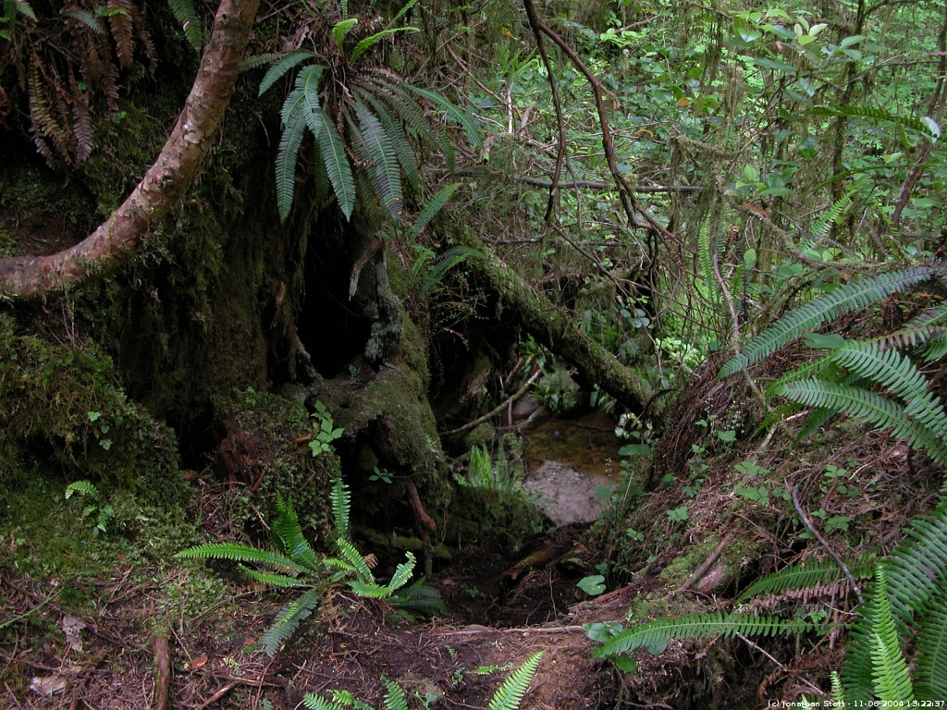
Let’s take a moment to imagine the world without multicellular organisms
Notes:
The evolution of multicellularity was revolutionary. Let’s take a moment to imagine the world without multicellular organisms…Without the trees, shrubs, herbs, animals, lichens, and fungi, this striking rainforest would be no more than a barren open landscape encrusted with a slimy layer of photosynthetic algae and bacteria….like this (next slide).
Image: $©$ Jonathan Stott Photography

Slide 5
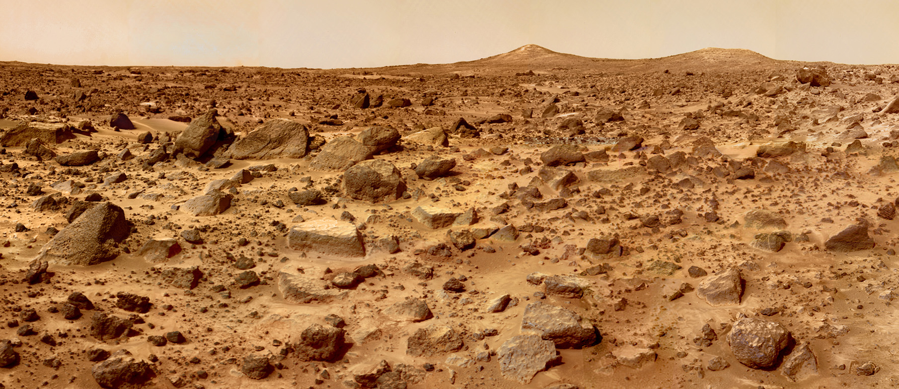
This is a photo of Mars
© NASA

Slide 6
The transition from uni- to multicellularity was one of a few events in the history of life that allowed for the evolution of large and complex organisms we see today
This is a photo of Mars
© NASA
Notes:
The transition from uni- to multicellularity was one of the few events in the history of life that allowed for the evolution of the large and complex organisms we see today.

Slide 7
The transition from uni- to multicellularity was one of a few events in the history of life that allowed for the evolution of large and complex organisms we see today
This transition occurred in the deep past (more than 200 million years ago) and most early multicellular forms have been lost to extinction
This is a photo of Mars
© NASA
Notes:
This transition occurred in the deep past, more than 200 mya, and most early forms of multicellular organisms have been lost to extinction.

Slide 8
The transition from uni- to multicellularity was one of a few events in the history of life that allowed for the evolution of large and complex organisms we see today
This transition occurred in the deep past (more than 200 million years ago) and most early multicellular forms have been lost to extinction
So how on earth do we study it?
This is a photo of Mars
© NASA
Notes:
So how on earth do we study it??

Slide 9
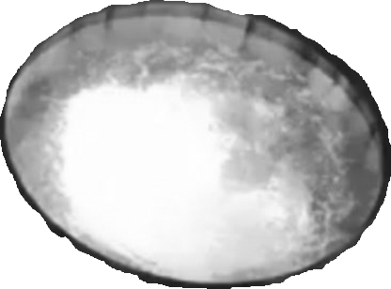
We could invent a time machine and observe this process as it’s happening
…or we could study it in the lab
Notes:
It seems that the best way of understanding this transition would be to invent a time machine, go back 600 million years, and observe this process as it’s happening. But unfortunately, this technology doesn’t exist. Instead, we can try to evolve multicellularity from scratch in the lab so we can observe this process as it happens.

Slide 10
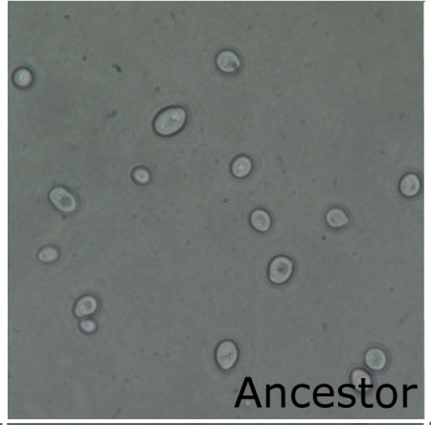
Time travel in a test tube
The left is a picture of the unicellular ancestor and the video is the evolved multicellular ‘snowflake’ yeast.
Notes:
This is exactly what scientists did. They experimentally evolved muticellular ‘snowflake’ yeast from a unicellular ancestor. The picture of the unicellular ancestor is on your left and the video is the evolved multicellular snowflake yeast.

Slide 11
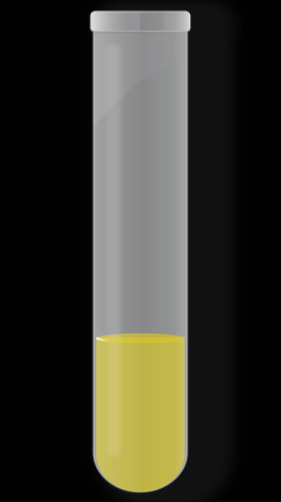
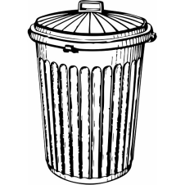
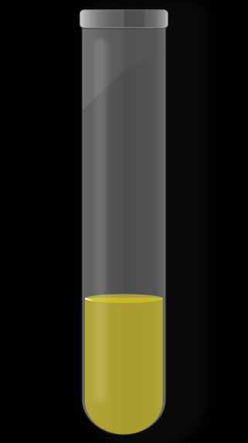
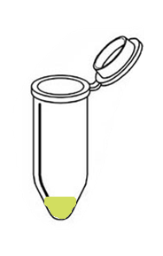
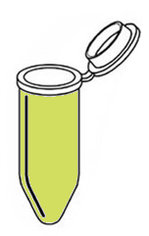
How did they do this?
24 hour, shaking
incubation
centrifuge 100g
for 10 seconds
discard upper
93% of media
transfer to fresh
media
Use gravity to select for clustering genotypes because clusters of cells settle more quickly than single cells.
Notes:
To evolve multicellular yeast, scientists used gravity to select for the clustering genotype that we saw in the previous cells. They did this because clusters of cells settling more quickly than single cells, allowing the scientists to select for groups of cells relatively easily. They started with 10 replicate populations of the unicellular yeast. To select for settling, they took yeast that have been growing for 24h and centrifuged 1.5 mL of at 100g for 10 seconds. After this, they discarded the upper 93% of the sample and transferred the bottom to fresh media, allowing only the heaviest things to survive.

Slide 12
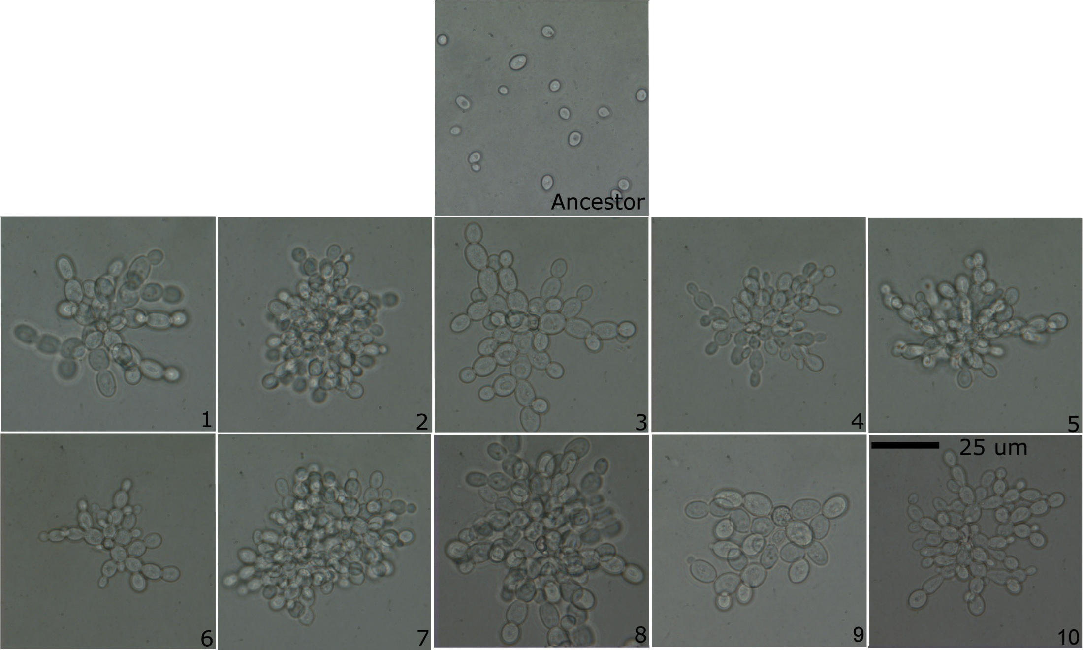
Independent evolution of the ‘snowflake’ yeast in all 10 replicate populations
Notes:
After 60 days, they saw independent evolution of snowflake clusters in all 10 replicate populations!

Slide 13
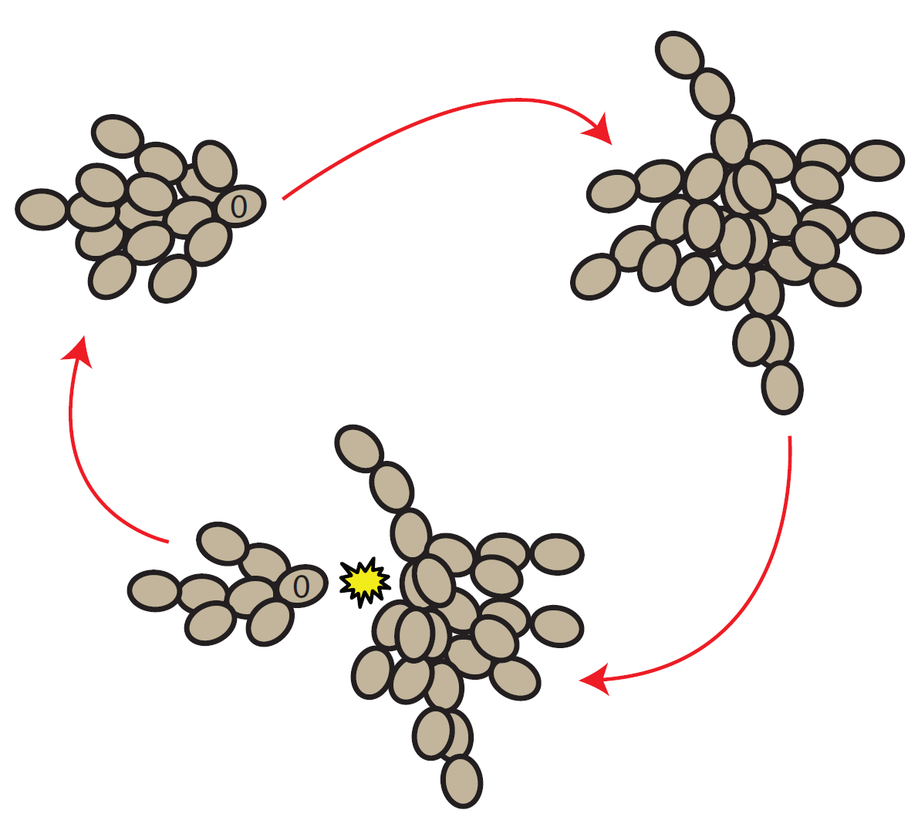
Some cool and important properties of snowflake yeast
A multicellular life cycle evolved. Snowflake yeast reproduce via multicellular propagules.
Notes:
Over the course of the experiment, the scientists observed some really cool and important properties of snowflake yeast. The snowflake yeast evolved a multicellular life cycle. Snowflake yeast reproduced by spitting off multicellular propagules.

Slide 14
A video of snowflake yeast life cycle
Notes:
Here is a video of the snowflake yeast life cycle. A single parent cluster will be labeled in blue, and the multicellular propagules will be labeled in green. A cool thing to notice is that the propagules are consistently smaller than the parent cluster.

Slide 15
Propagules are functionally juvenile
maturation
reproduction
The multicellular propagules turn out to be functionally juvenile, meaning they have to grow back to their parent size before they can reproduce themselves
Notes:
This turns out to be really important because these propagules turn out to be functionally juvenile, meaning that they have to grow back up to their parent size before they can reproduce themselves. This is displayed in the picture here.

Slide 16
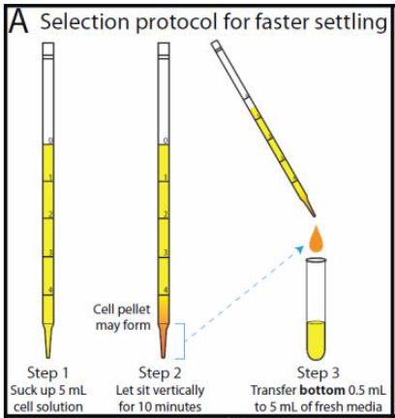
In this lab…
You will try to induce your own yeast to make this great evolutionary leap, from uni- to multicellularity, using experimental evolution – the use of controlled experiments to test hypotheses and theories of evolution
Like Ratcliff et. al 2011, you will use gravity to select for clustering genotypes
Clusters of cells settle quicker than single cells, allowing us to separate out single cells from multi-celled mutants that arise through the experiment
Selection protocol
First, let’s talk about the steps involved in this transition

Slide 17
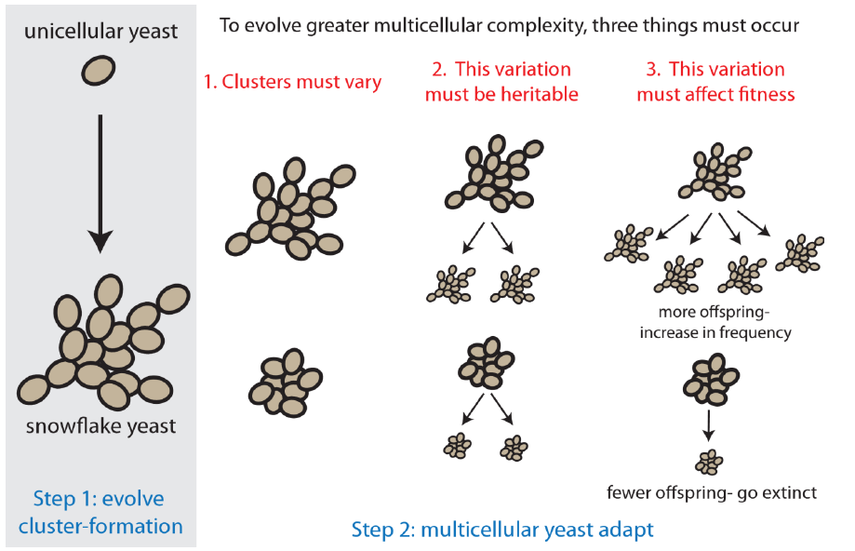
Two steps are required for the transition to multicellularity
We will try to examine both of these steps in this lab
Notes:
**This is figure 2 from lab 1 overview.
There are two steps required for the transition to multicellularity, and we will try to examine both of these steps with this lab.

Slide 18
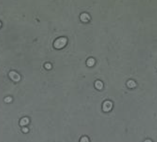
Step 1 – the evolution of clusters
The first step in this transition is the evolution of cluster formation from single-celled ancestors
This could be beneficial for many reason in nature:
Predator evasion
Metabolic cooperation
UV resistance
Y55 - Unicellular Saccharomyces cerevisiae (bakers yeast)
Notes:
**This is figure 2 from lab 1 overview.
The first step in this transition is the evolution of clusters from single-celled ancestors. This could be beneficial for many reasons. This could include evasion from predators, metabolic cooperation, and UV resistance.

Slide 19
Step 2 – multicellular yeast adapt
Three things must be true for multicellular yeast to adapt
Notes:
**This is figure 2 from lab 1 overview.
The second step, and a very important step, is that multicellular yeast adapt. Three things must be true for this step to occur.

Slide 20
Clusters must vary from one another
Snowflake
Not snowflake (clumpy yeast)
Notes:
**This is figure 2 from lab 1 overview.
First, clusters much vary from one another. Shown are two different ways of forming a cluster – snowflake and clumping together, which I will call clumpy yeast. You can see that they are very different from one another.

Slide 21
Cluster variation must be heritable
Snowflake yeast make more snowflake yeast
Clumpy yeast make more clumpy yeast
Notes:
**This is figure 2 from lab 1 overview.
Second, the cluster variation shown in the last slide must be heritable. This means that snowflake yeast make more snowflake yeast, and clumpy yeast make more clumpy yeast.

Slide 22
Cluster variation much affect fitness
The three components of Step 2 are known as evolution via natural selection.
Notes:
**This is figure 2 from lab 1 overview.
Finally, the variation that we’ve been talking about must affect fitness. What I mean by that is that one must be better at surviving than the other. You can see that in this diagram because snowflake yeast make more offspring than clumpy yeast, which will allow the snowflake yeast to increase in frequency and possibly take over the population. The three components of step 2 are known as evolution via natural selection. This is important because over time, this can result in the evolution of multicellular complexity.

Slide 23
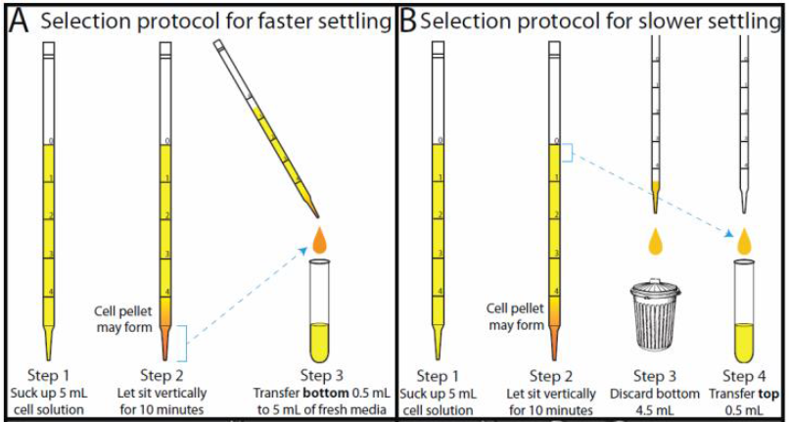
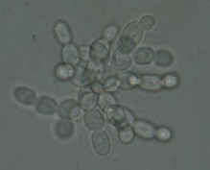
Has Step 2 occurred in snowflake yeast?
The second part of this lab will be to examine if snowflake yeast have the ability to adapt to novel environments through a divergent selection experiment
C1W3 – Snowflake yeast
The two novel environments we will subject snowflake yeast to: fast-settling and slow-settling
Notes:
The second part of lab will be to examine if step 2 has occurred in snowflake yeast: to see if snowflake yeast have the ability to adapt to novel environments. We will do this through a divergent selection experiment. The two environments that we will subject snowflake yeast to are fast settling and slow settling environments.

